Slide 1


Network Analyzer Example
Internet
User clicks on http://www.nytimes.com/
Ethereal network analyzer captures all frames observed by its Ethernet NIC
Sequence of frames and contents of frame can be examined in detail down to individual bytes

Slide 2
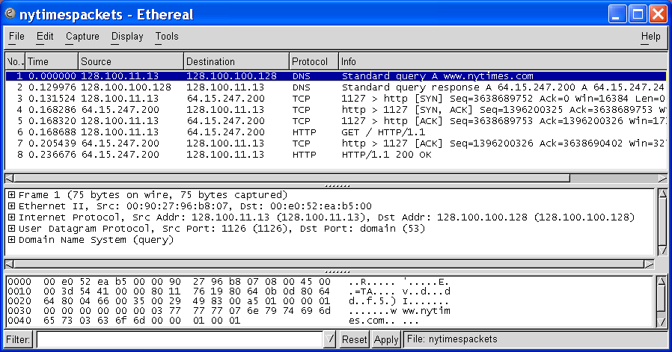
Ethereal windows
Top Pane shows frame/packet sequence
Middle Pane shows encapsulation for a given frame
Bottom Pane shows hex & text

Slide 3
Top pane: frame sequence
TCP Connection Setup
DNS Query
HTTP Request & Response

Slide 4
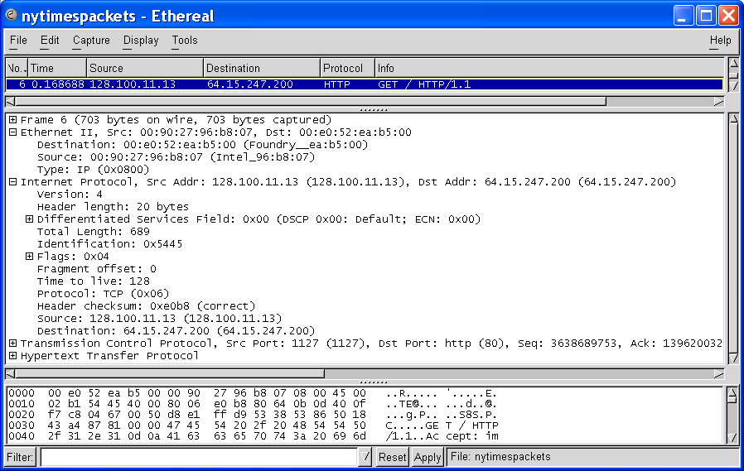
Middle pane: Encapsulation
Ethernet Frame
Ethernet Destination and Source Addresses
Protocol Type

Slide 5
Middle pane: Encapsulation
And a lot of other stuff!
IP Packet
IP Source and Destination Addresses
Protocol Type

Slide 6
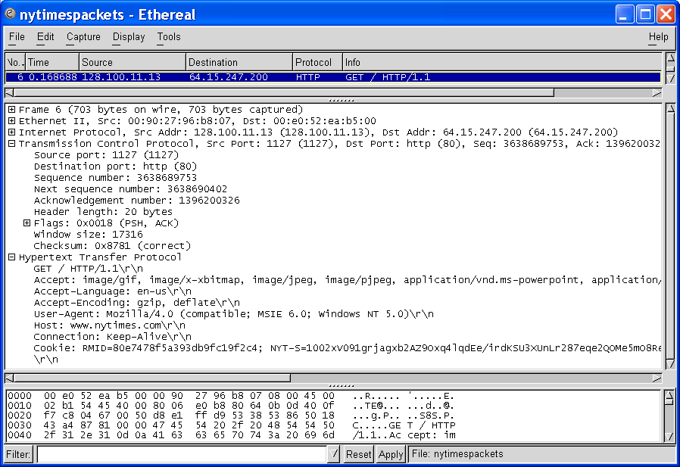
Middle pane: Encapsulation
TCP Segment
Source and Destination Port Numbers
GET
HTTP Request

